Slide 1
Outlook for 2017
Professor Steven Kyle
Cornell University
January 24, 2017

Slide 2
Grading My Predictions from Last Year
Most economists are taught to avoid naming both a number and a date
I do it anyway every year and post the results on my website
How did I do last time?

Slide 3
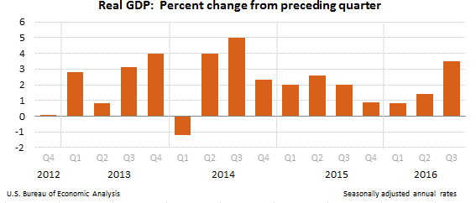
GDP
Prediction was 3% - Outcome looks pretty close to that once 4th quarter numbers are in

Slide 4
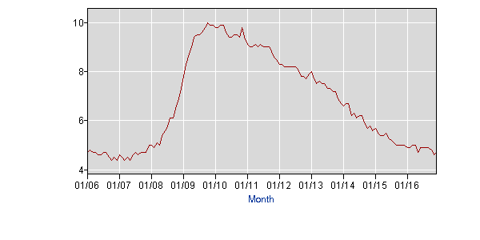
Unemployment Prediction “5 to 5 ½ %” Outcome – 4.7%

Slide 5
Inflation Prediction - “No evidence of inflation” - Outcome – Pretty close to that

Slide 6
Interest rate forecast: “1% or less (probably less)” Spot on.

Slide 7
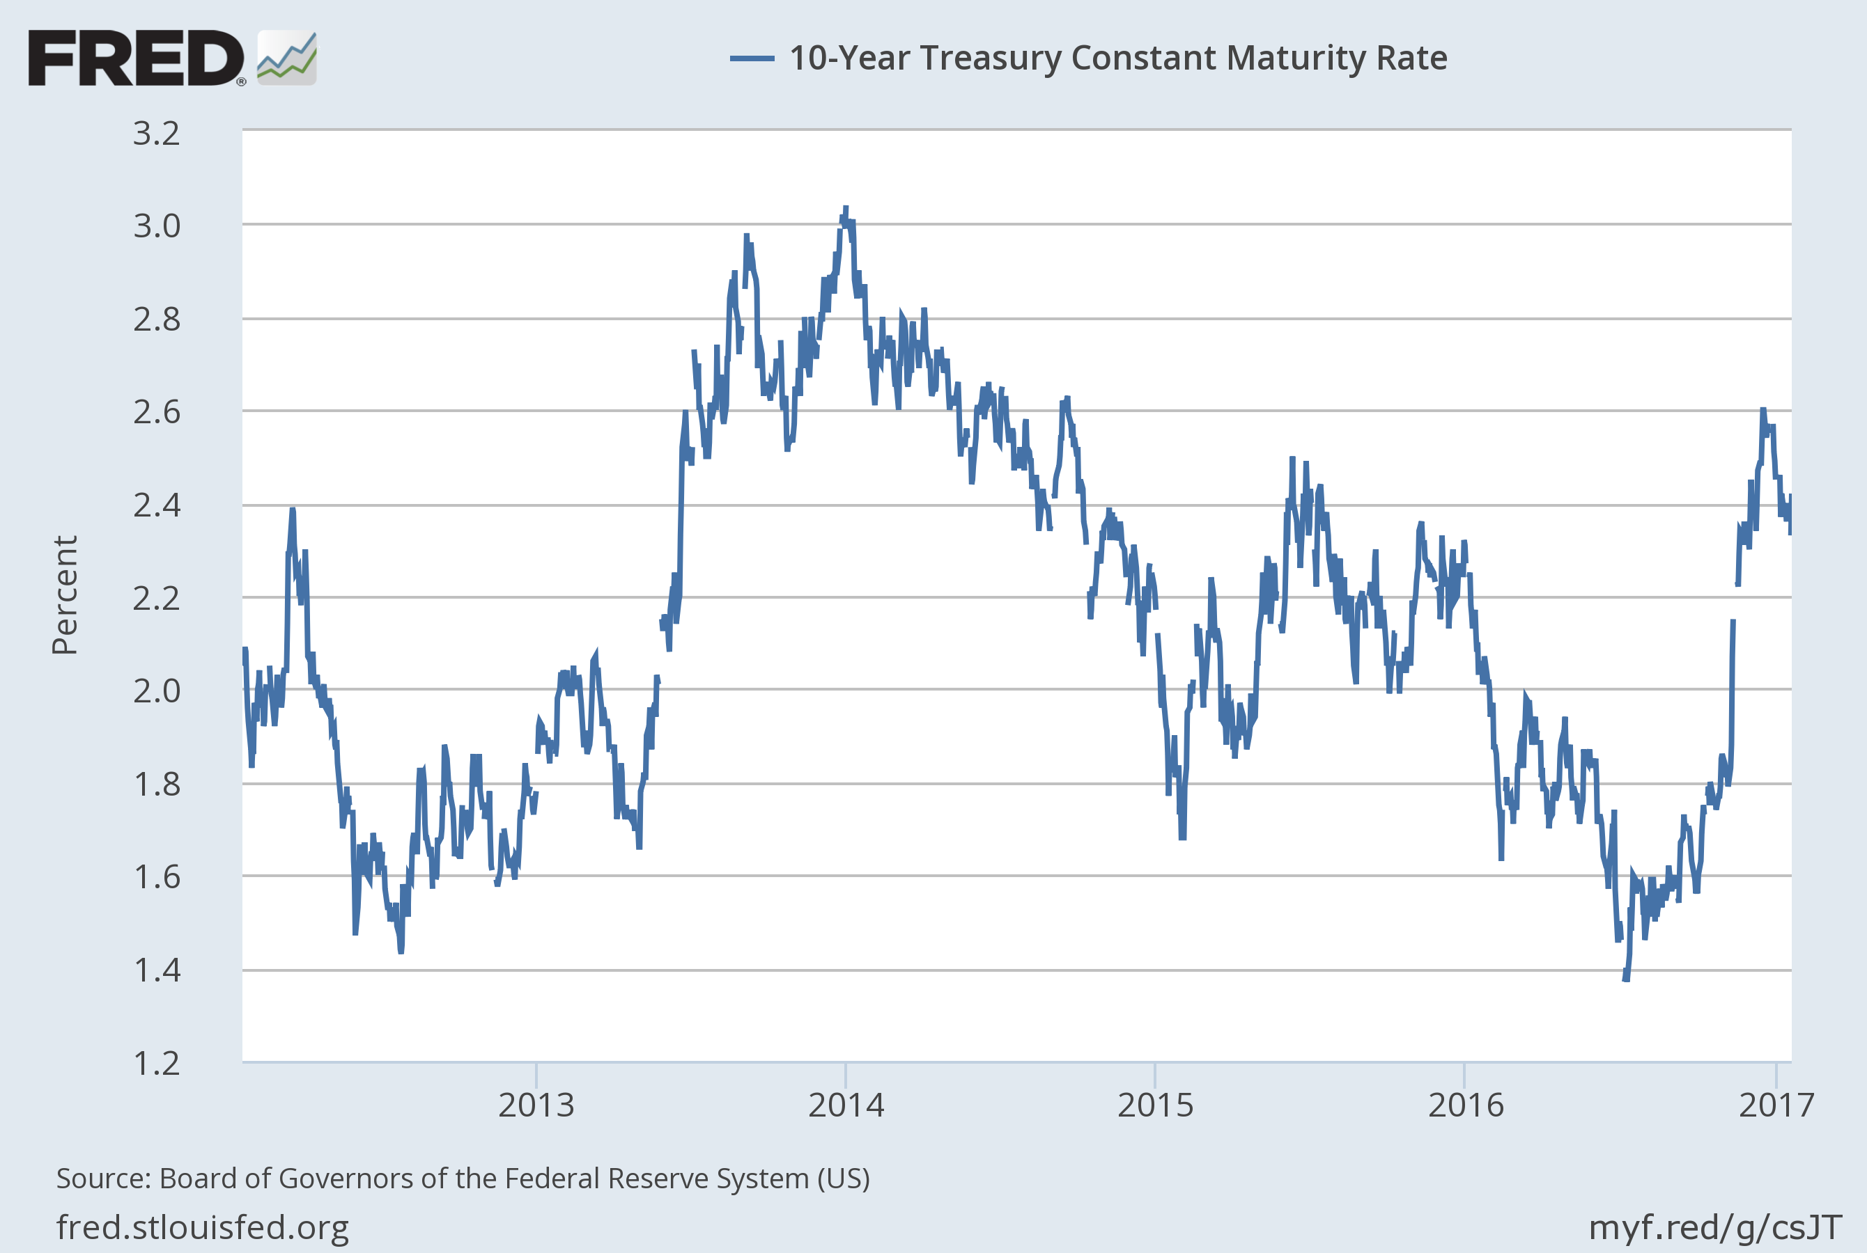
“ … long rates may creep up”

Slide 8
And My Grade for Last Year’s Prediction Is ……
I get an A Minus !!!!!!!!!!!!!!

Slide 9
Where We Are Now: Business Cycle Indicators
Still plodding along in our expansion – Now in 6th year
No reason to think that because it is old it is time for a turnaround but spending policy in the coming year will be important factor
Some indicators look like they are near a cyclical high but for the most part coincident indicators looking OK
Housing market nearing what we might call “normal”

Slide 10
Most States Looking Like They Are In the Green

Slide 11
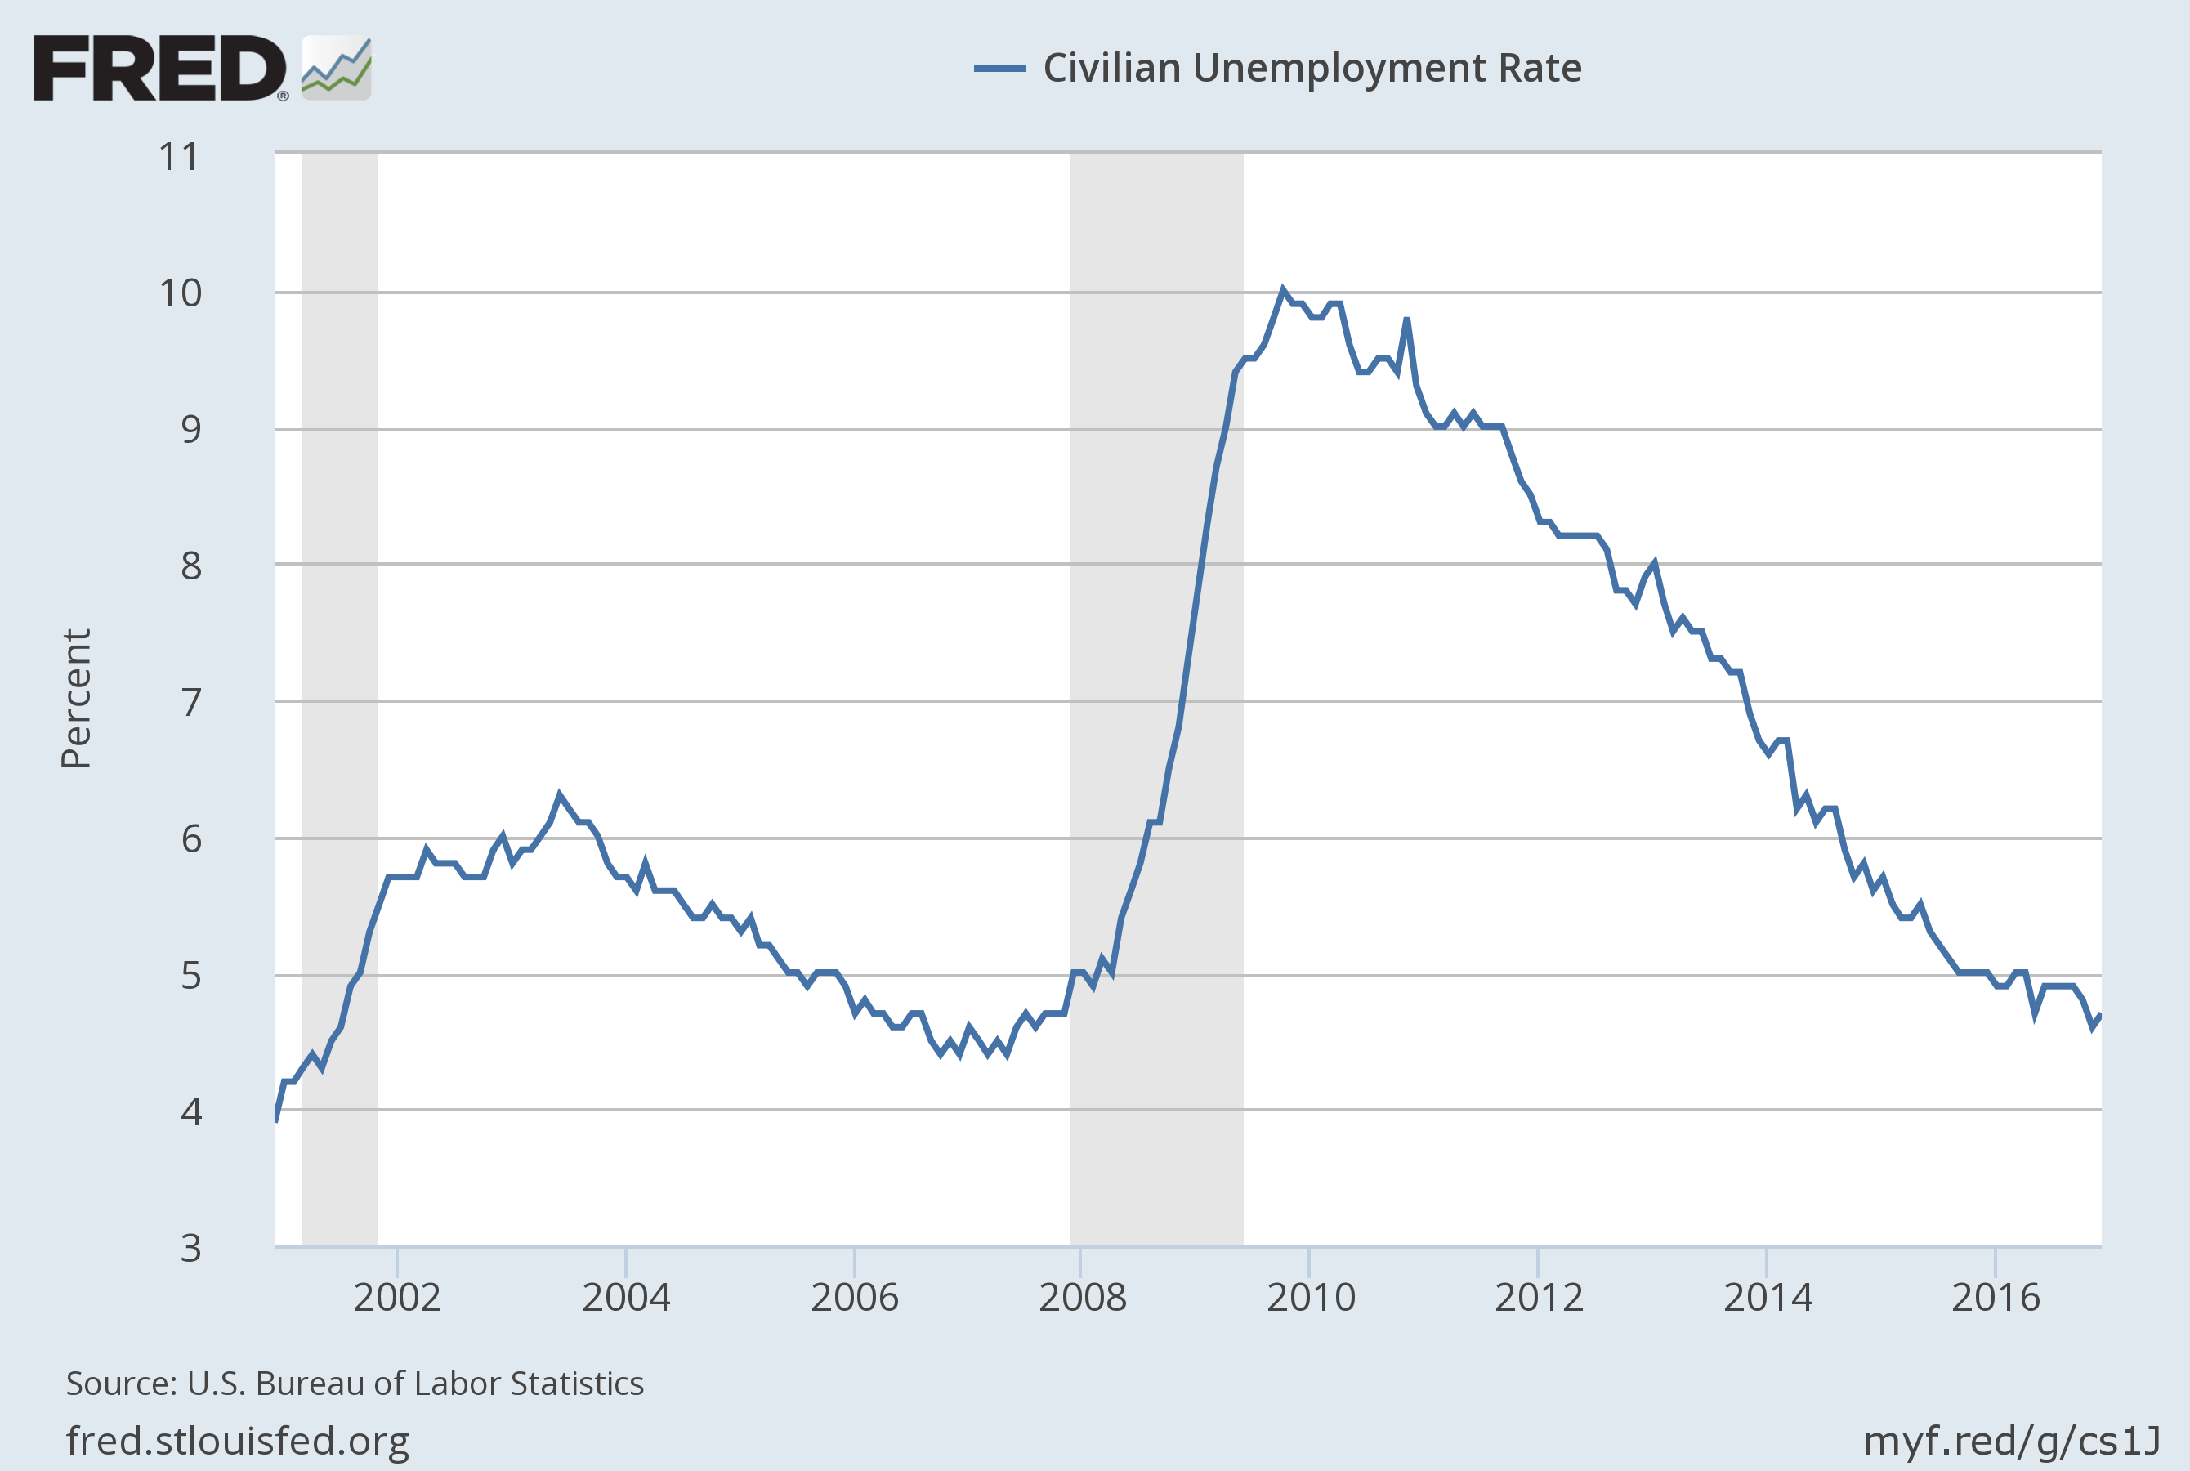
Unemployment Has Dropped to 4.7%
Notes:
Source:
US. Bureau of Labor Statistics
Release:
Employment Situation
The unemployment rate represents the number of unemployed as a percentage of the labor force. Labor force data are restricted to people 16 years of age and older, who currently reside in 1 of the 50 states or the District of Columbia, who do not reside in institutions (e.g., penal and mental facilities, homes for the aged), and who are not on active duty in the Armed Forces.This rate is also defined as the U-3 measure of labor underutilization.The series comes from the 'Current Population Survey (Household Survey)'The source code is: LNS14000000
US. Bureau of Labor Statistics,
Civilian Unemployment Rate [UNRATE],
retrieved from FRED,
Federal Reserve Bank of St. Louis;
https://fred.stlouisfed.org/series/UNRATE,
December 7, 2016.

Slide 12
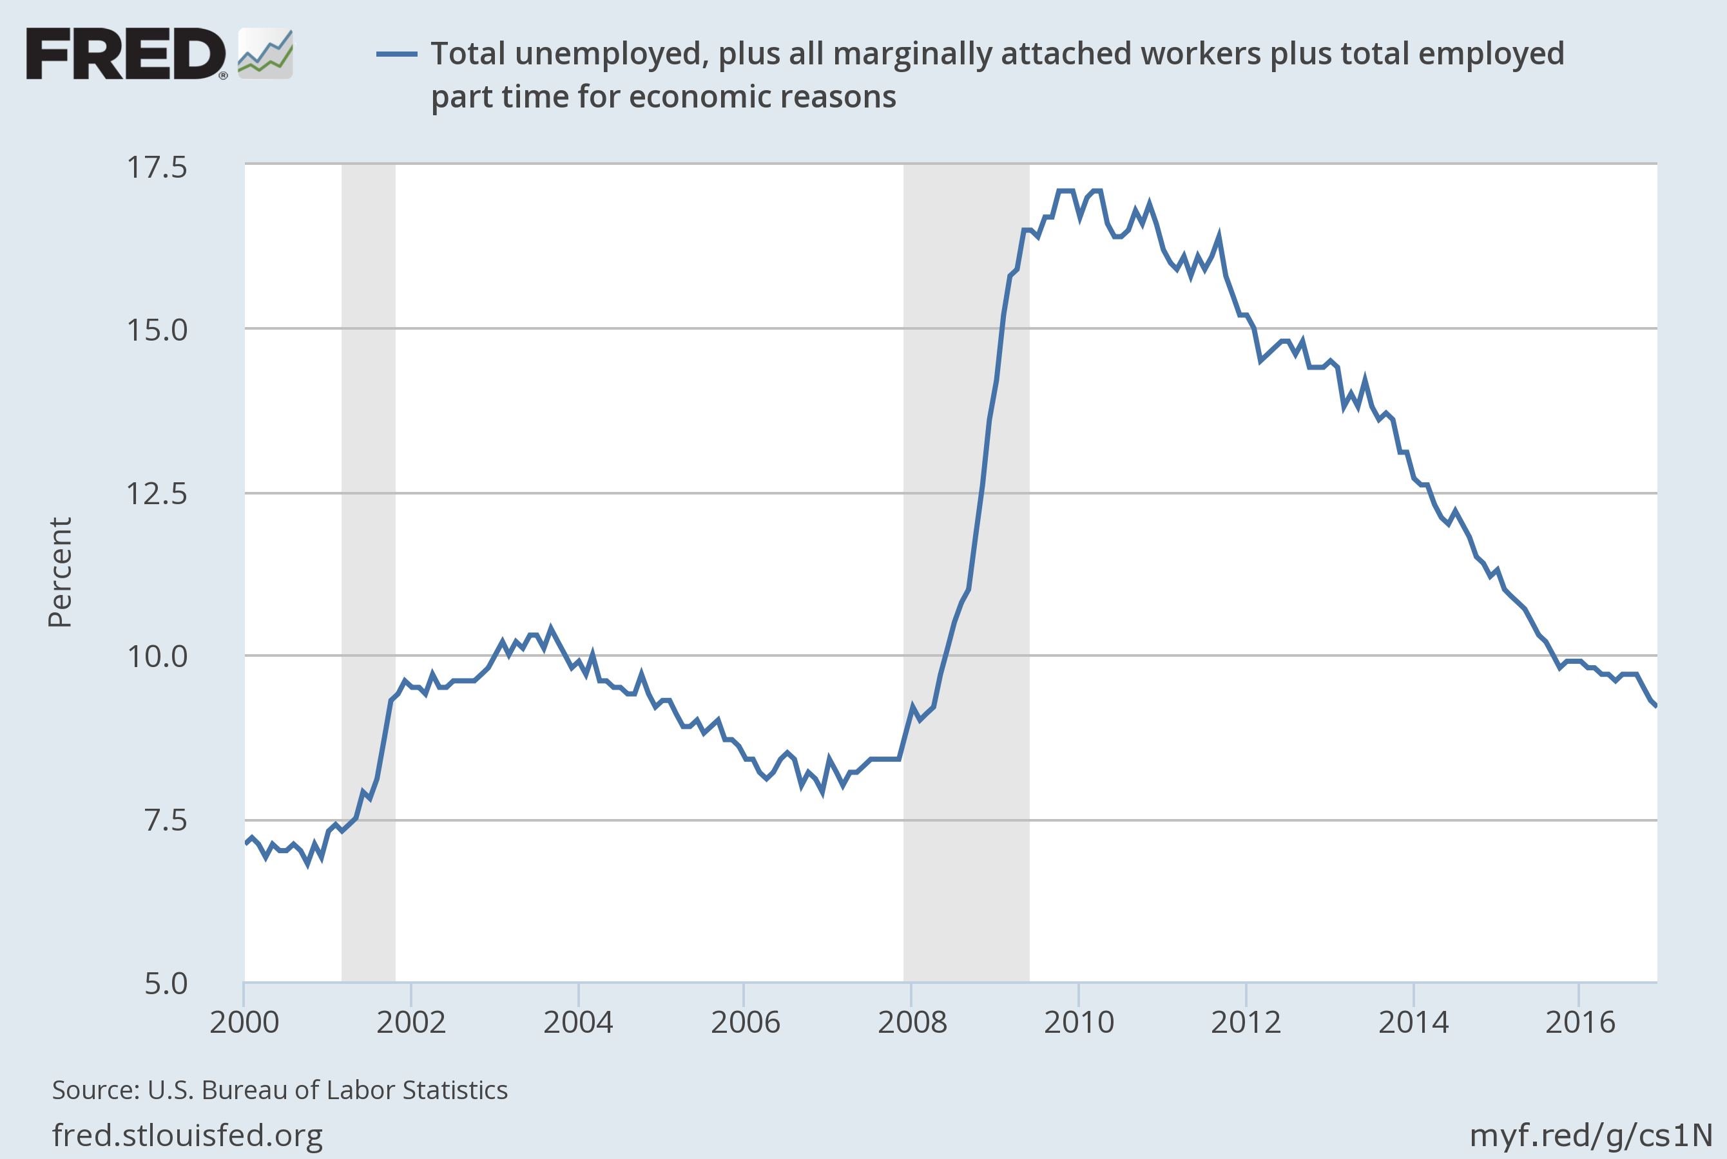
Though Headline Unemployment is Well Below 5%, U6 Is Still Pretty High
Notes:
Source:
US. Bureau of Labor Statistics
Release:
Employment Situation
The series comes from the 'Current Population Survey (Household Survey)'The source code is: LNS13327709
US. Bureau of Labor Statistics,
Total unemployed, plus all marginally attached workers plus total employed part time for economic reasons [U6RATE],
retrieved from FRED,
Federal Reserve Bank of St. Louis;
https://fred.stlouisfed.org/series/U6RATE,
November 3, 2016.

Slide 13
Industrial Production Still Not Above Previous Peak

Slide 14
Capacity Utilization Still in Mid 70’s Range

Slide 15
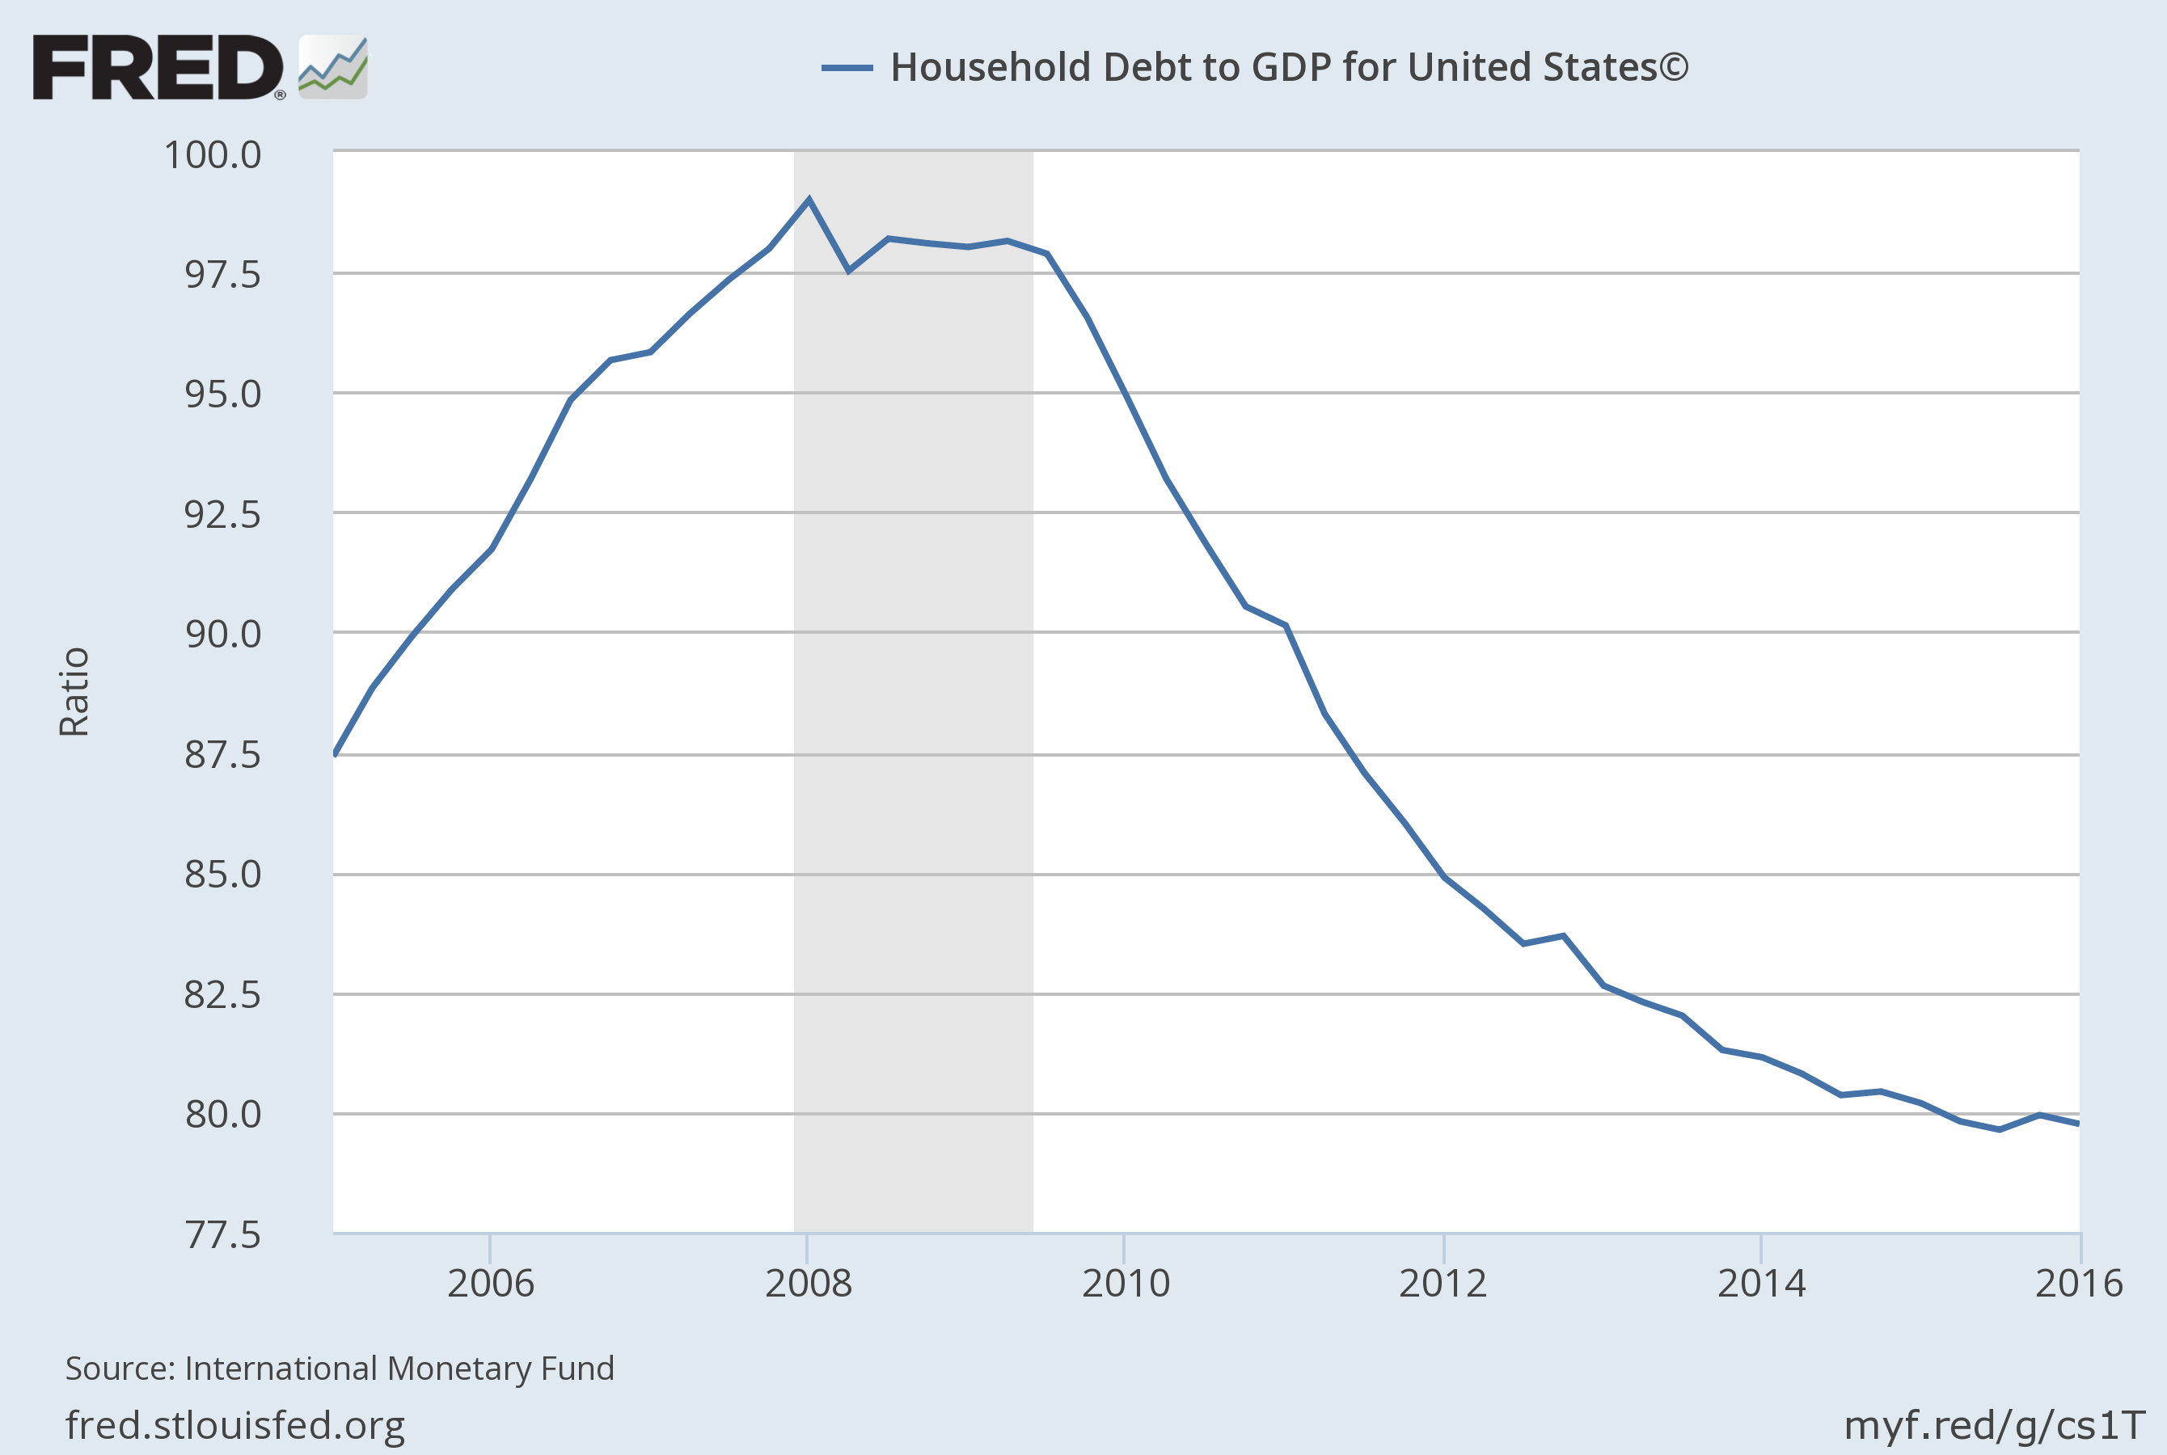
Household Debt at Historically Low Levels

Slide 16
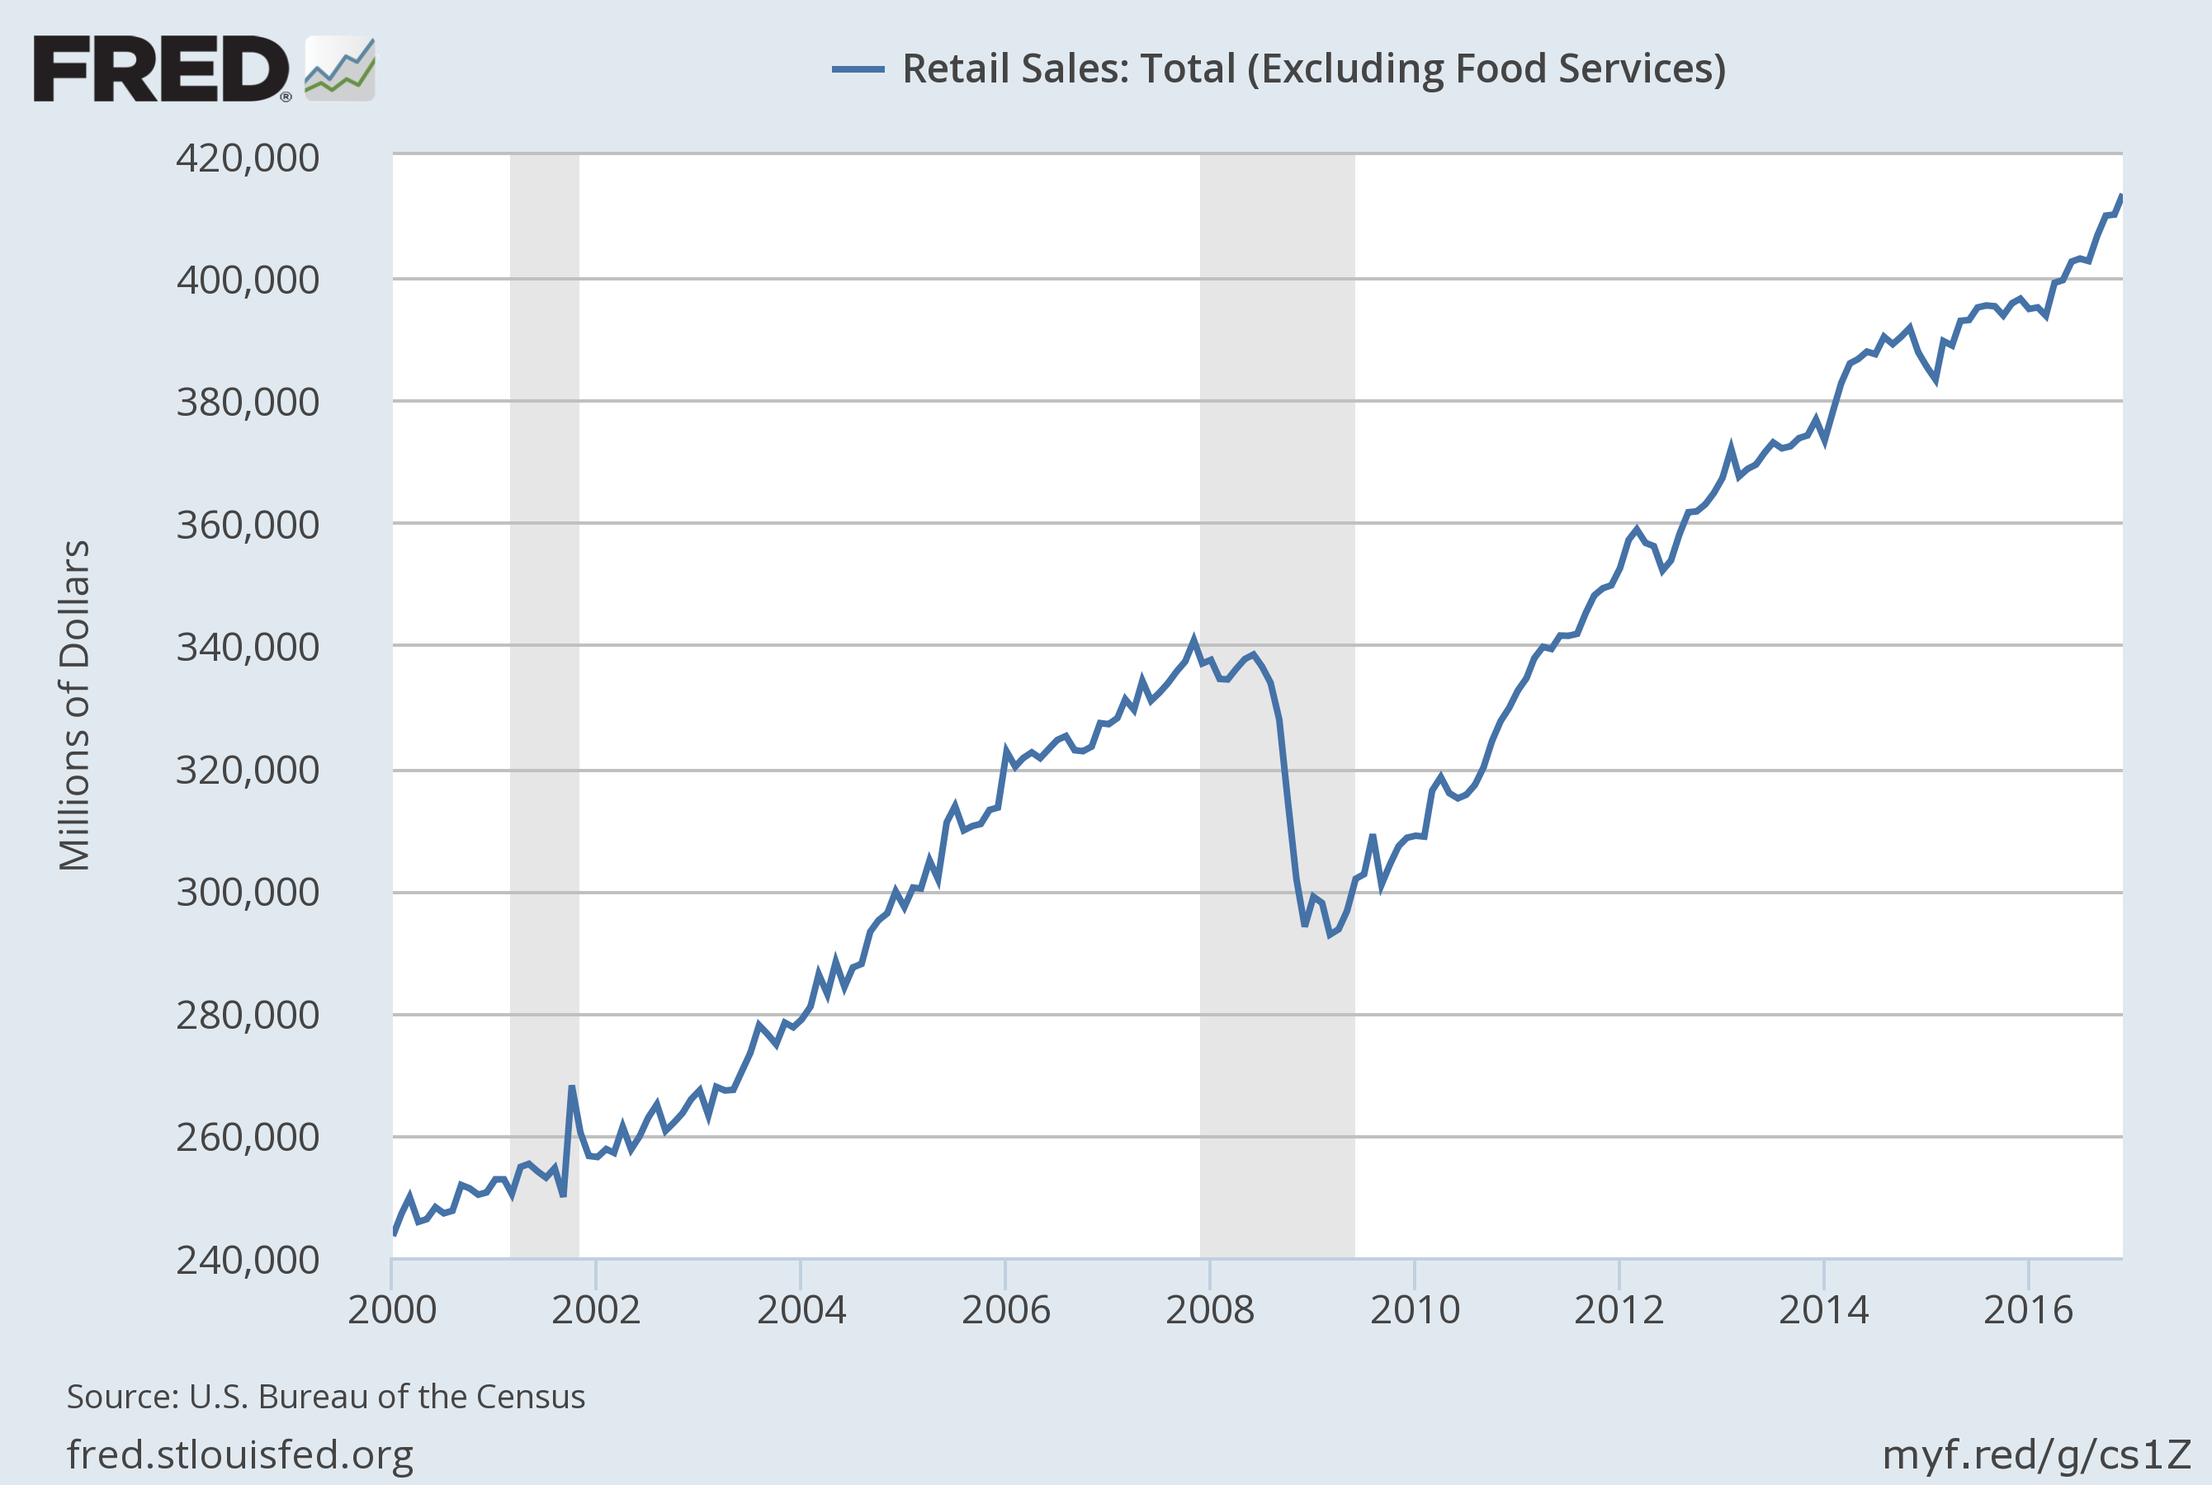
Retail Sales Continue to Pull Us Along (Remember, this is 70% of GDP)

Slide 17
Still No Major Wage Inflation: But this is what will drive inflation
causing the Fed interest rate hikes in the coming year

Slide 18
Housing Market
Nominal house prices still not up to previous peak (So some folks are still under water but these are a steadily declining group)
Real prices look OK compared to historical levels
Price/Rent ratio maybe a little high but not too much – New Normal?
But New Home Sales still low – This is what gives a boost to GDP

Slide 19
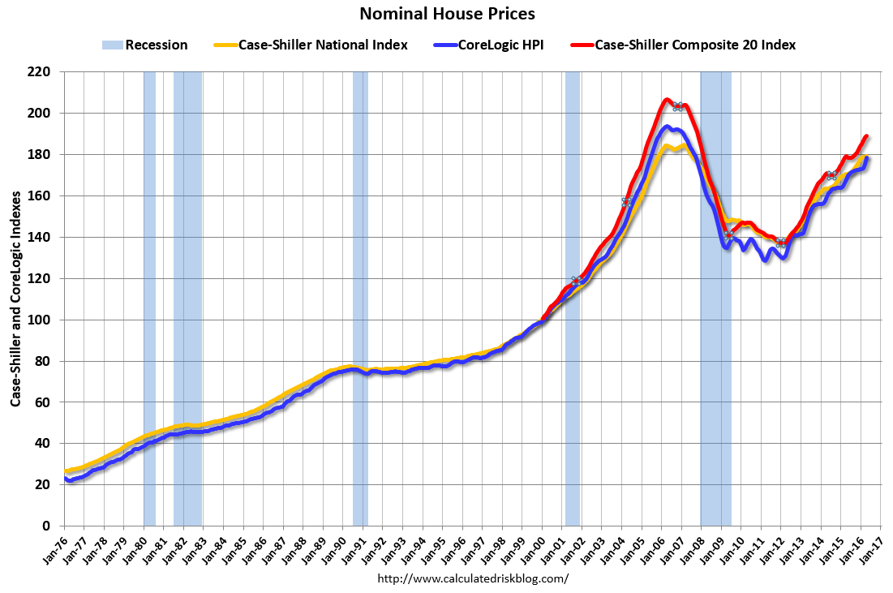

Slide 20
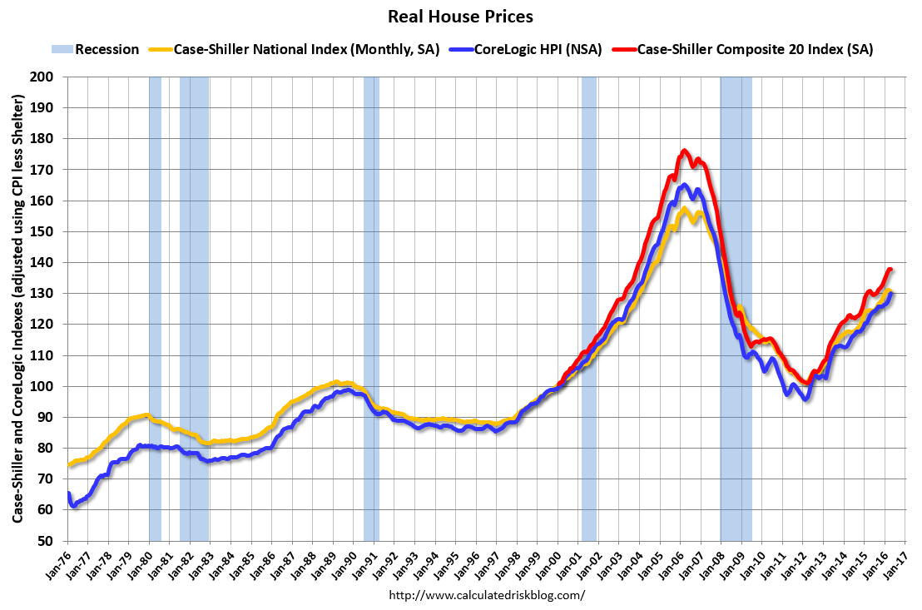

Slide 21
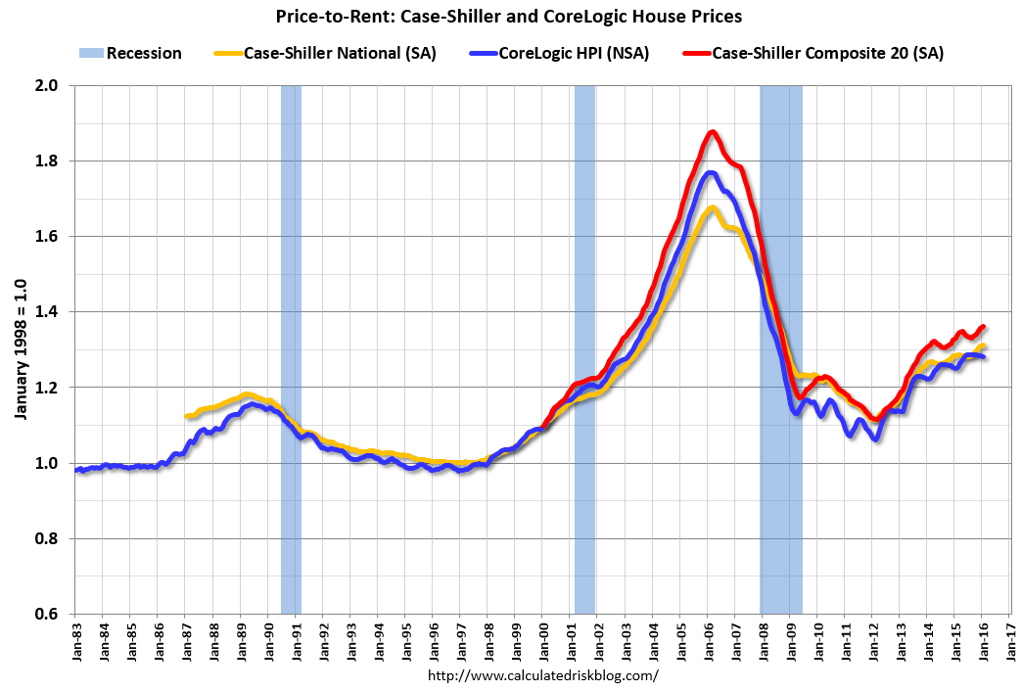

Slide 22
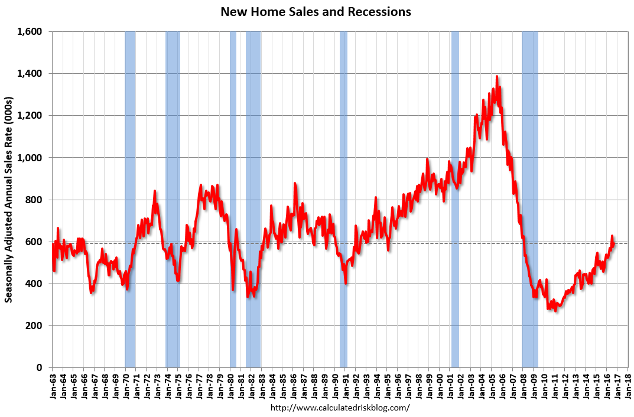

Slide 23
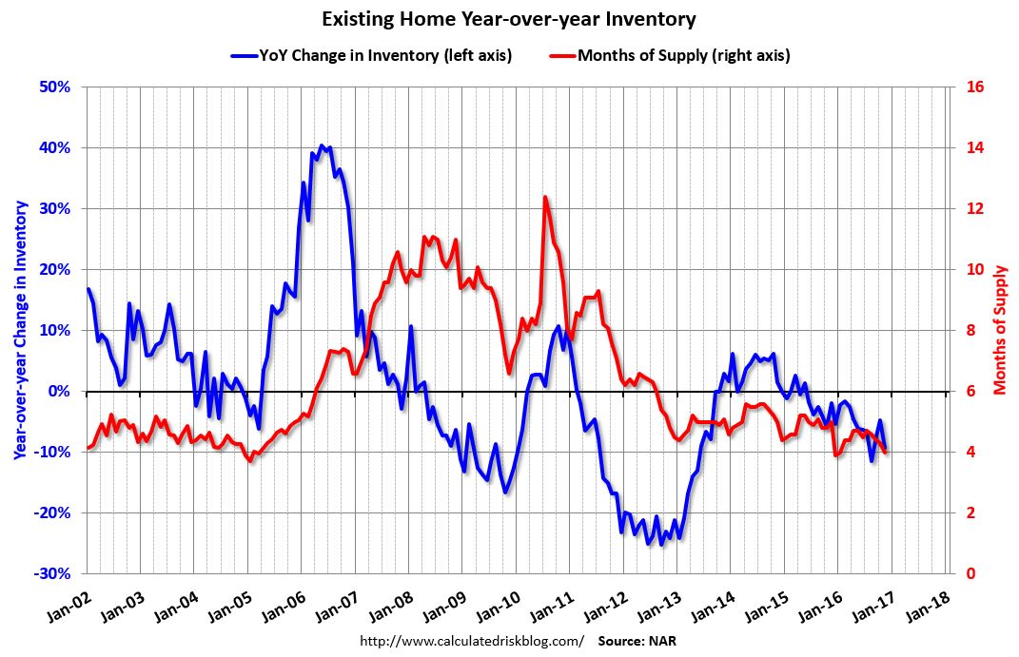

Slide 24
Current Policy Stance – Monetary Policy
Fed recently raised interest rates another quarter point and are likely to continue with gradual quarter point increases
Their favorite inflation measure is still below 2% target
  But other measures above 2% now: more hikes in the next year
Unemployment figures still an unknown – U3 low but U6 high
If/when interest rates rise, dollar will strengthen
  This will help keep inflation down
  Commodity prices too

Slide 25
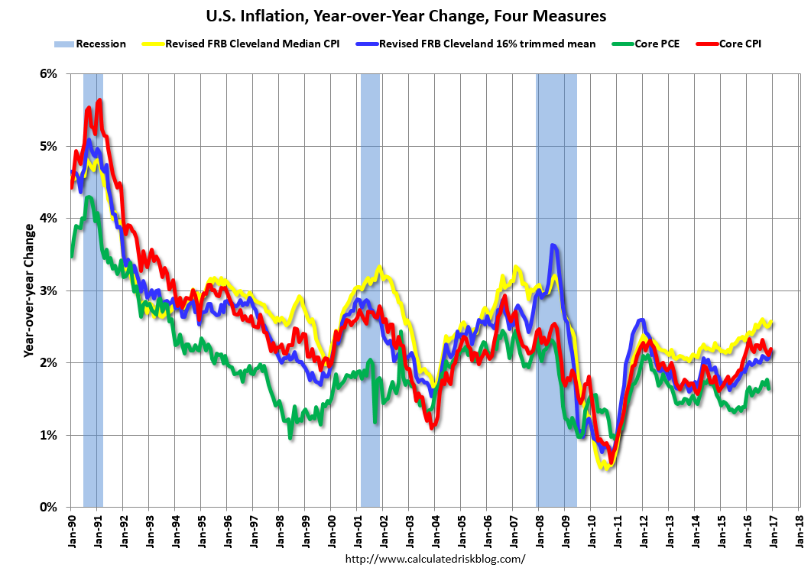

Slide 26
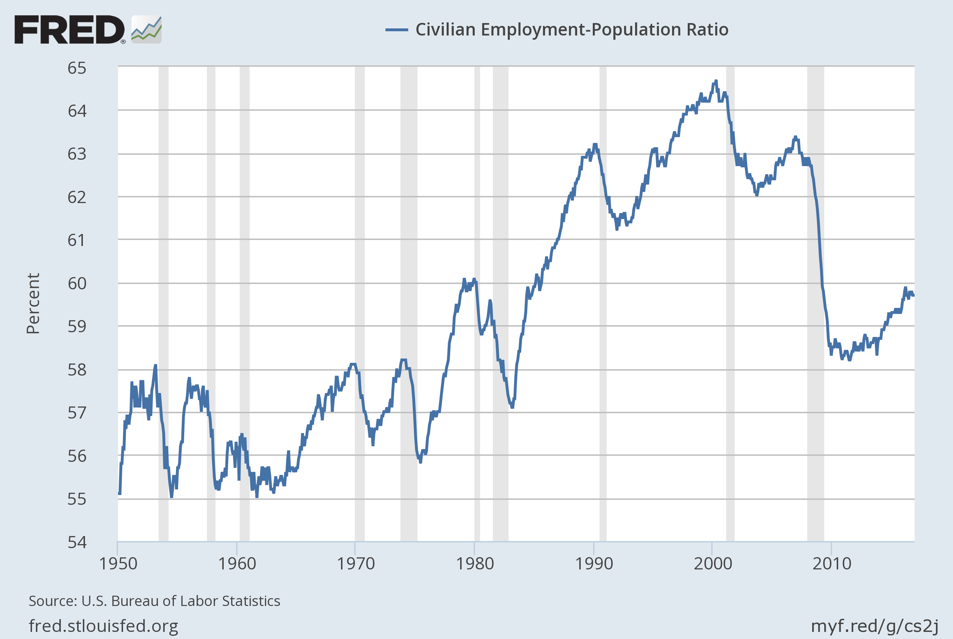
Are those missing workers out there ever coming back?
Notes:
Source:
US. Bureau of Labor Statistics
Release:
Employment Situation
The series comes from the 'Current Population Survey (Household Survey)'The source code is: LNS12300000
US. Bureau of Labor Statistics,
Civilian Employment-Population Ratio [EMRATIO],
retrieved from FRED,
Federal Reserve Bank of St. Louis;
https://fred.stlouisfed.org/series/EMRATIO,
November 7, 2016.

Slide 27
You can buy a Euro for around $1.10

Slide 28
Current Policy Stance: Fiscal Policy
Over past 6 years, freezing spending levels in a growing economy implies a gradual tightening in per capita terms –
Deficit now clearly under control
New spending on infrastructure or other public investment?
  We NEED it
  Whether we get it is a political decision

Slide 29
Retail Sales and Household Debt
Unemployment not too high
Household debt low
So no reason for consumption to be a drag on growth

Slide 30
Leading Indicators Looking Pretty Good in Most of the Country

Slide 31
And the Election Means …….
I didn’t see this coming
But now we have a combination of two things:
  Mr. Trump won – but he is all over the map with respect to economic policy
  The Republicans now control all branches of government
So, taking Mr. Trump at his word and combining that with Republican control, what can we say?

Slide 32
If Trump and Republicans Do What They Said They Wanted to Do
There is now more uncertainty than before
  Markets and investors hate that
Republicans have sworn to cut spending. With interest rates already near zero the capacity of the government to respond to any negative shocks is very limited
Trump ran on a series of proposals which are in and of themselves negative economic shocks
  Withdraw from trade deals
  Deport undocumented workers
  Repeal Obamacare

Slide 33
If Trump and the Republicans Are More Willing to Tolerate Deficits Now That THEY Are In Charge…..
Note that higher spending will matter but only after a lag
Higher military spending
Tax cuts, but probably skewed to upper income
Infrastructure projects? (As I have said a million times, we need this)
  Key is how they are funded
  If new spending then it’s a stimulus; if it’s tax incentives, then the devil is in the details but this is a less effective method to stimulate and has its own problems

Slide 34
Predictions
GDP growth at around 3%;
Unemployment 4 ½ - 5%
Inflation – Still not a worry, especially if economy turns soft later
Interest rates – Fed will likely impose rate increases (2-3?) next year – but only a ¼% at a time – We will reach 1% at short end by a year from now (possibly 1 ½ % if economy continues strong)
Fiscal Policy? The big question …
Exchange Rate: Higher interest rates mean a continued strong dollar which will help dampen inflation but also commodity prices

